Slide 1
How To Build Android App
Android Mobile Development

Slide 2
Introduction
Android apps can be build using Java language
But it’s not the only way to create an android apps

Slide 3


Native VS Hybrid VS HTML5
There are 3 ways of building Android app, that is :
Native apps are specific to a given mobile platform (iOS or Android) using the development tools and language that the respective platform supports (e.g., Xcode and Objective-C with iOS, Eclipse and Java with Android). Native apps look and perform the best.

Slide 4
HTML5
HTML5 apps use standard web technologies—typically HTML5, JavaScript and CSS.
This write-once-run-anywhere approach to mobile development creates cross-platform mobile applications that work on multiple devices.
While developers can create sophisticated apps with HTML5 and JavaScript alone, some vital limitations remain at the time of this writing, specifically session management, secure offline storage, and access to native device functionality (camera, calendar, geolocation, etc.)

Slide 5
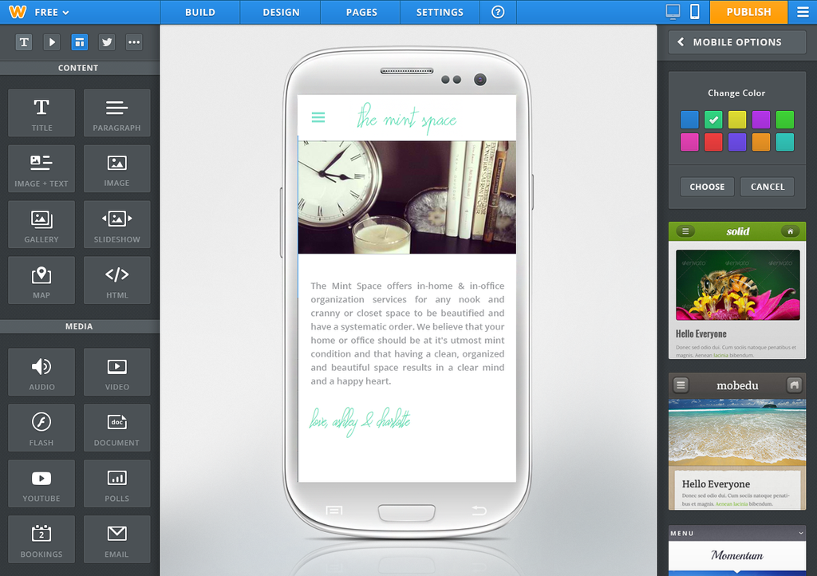
HTML5

Slide 6





HTML5

Slide 7
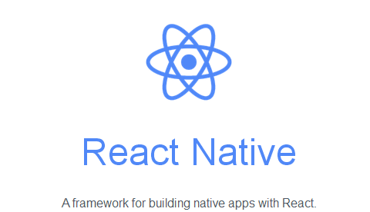


Hybrid
Hybrid apps make it possible to embed HTML5 apps inside a thin native container, combining the best (and worst) elements of native and HTML5 apps.

Slide 8
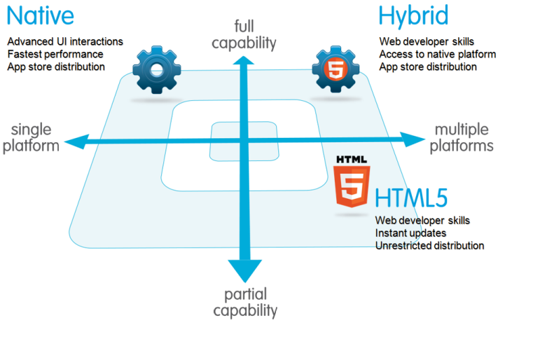
Native VS Hybrid VS HTML5

Slide 9
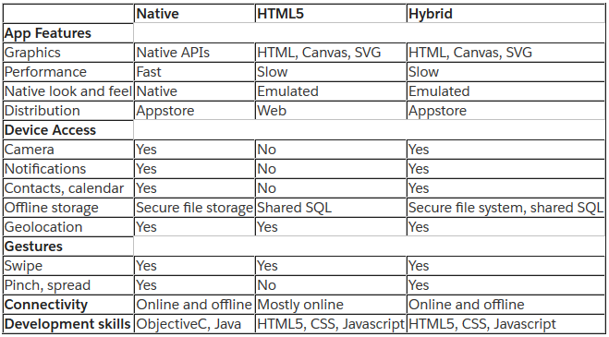
Native VS Hybrid VS HTML5

